Slide 1

Diabetes Risk Prediction System Using Streamlit
V.Bhaskar
MCA
Healthcare Analytics

Slide 2

Problem Statement
Diabetes cases increasing rapidly
Traditional diagnosis is time-consuming
No instant visual feedback

Slide 3

Objectives & Purpose
Predict diabetes risk
Show confidence score
Visualize health data
Healthcare awareness
Educational use

Slide 4

Proposed System & Workflow
Web-based diabetes risk prediction system
Instant results
Graphical visualization
User → Input Data → Risk Calculation → Graphs → Result

Slide 5

Technologies & Modules
Python
Streamlit
Pandas
Visualization
User Input Module
Prediction Logic
Dashboard & Graphs

Slide 6
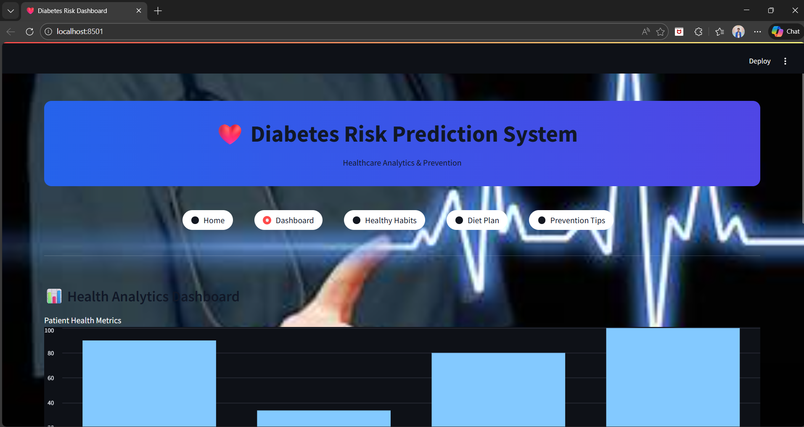
Features & Output
Risk level with confidence %
Bar chart for health metrics
Line chart for risk contribution
Diet & Prevention tips

Slide 7

Advantages & Future Scope
Advantages:
Easy
Fast
Low cost
Future:
ML Integration
Mobile App

Slide 8
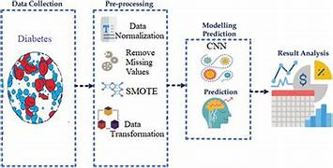
Thank You

